Slide 1
Build Beautiful Documentation
Josh Hendricks
@joshooaj
1 / 15

Slide 2

Thank You!

Slide 3

whoami
Joshua J Hendricks (@joshooaj)
Principal Engineer at Milestone Systems
Roots in software vendor tech support
Evolved into a developer to make the job easier
Not affiliated with the companies behind any of the technology in this workshop

Slide 4
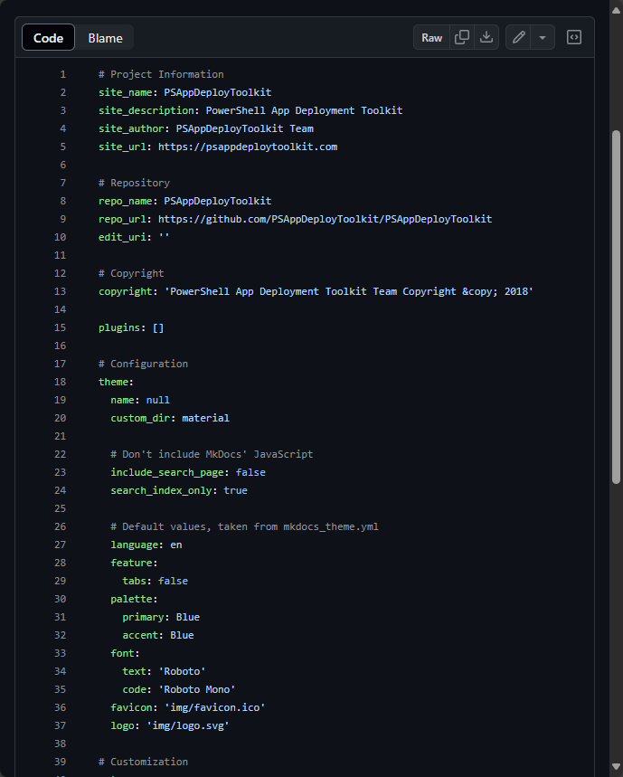
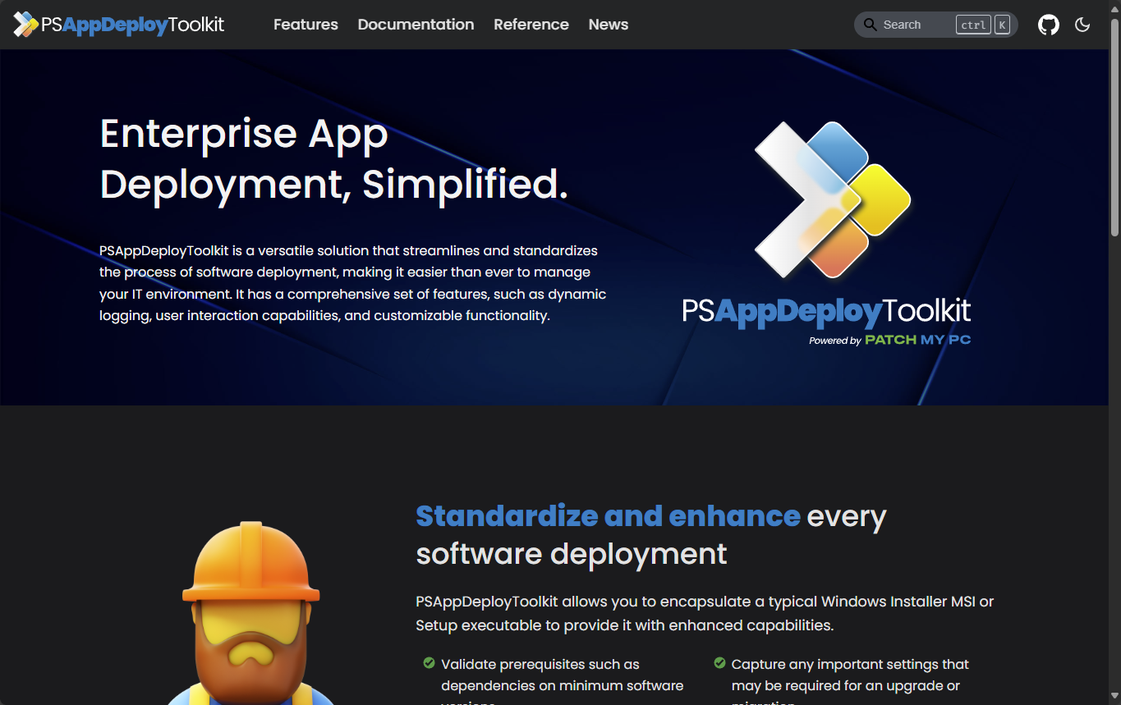
PSAppDeployToolkit

Slide 5
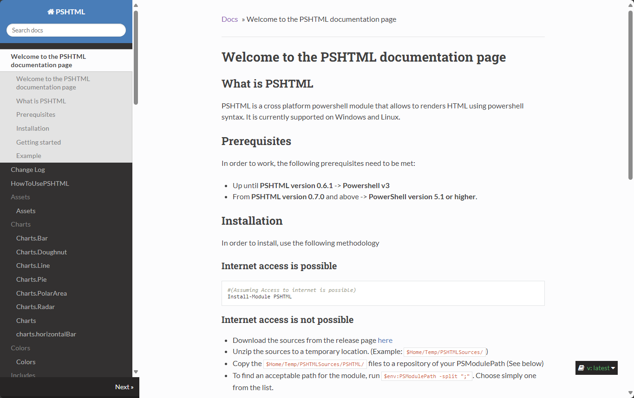
PSHTML

Slide 6
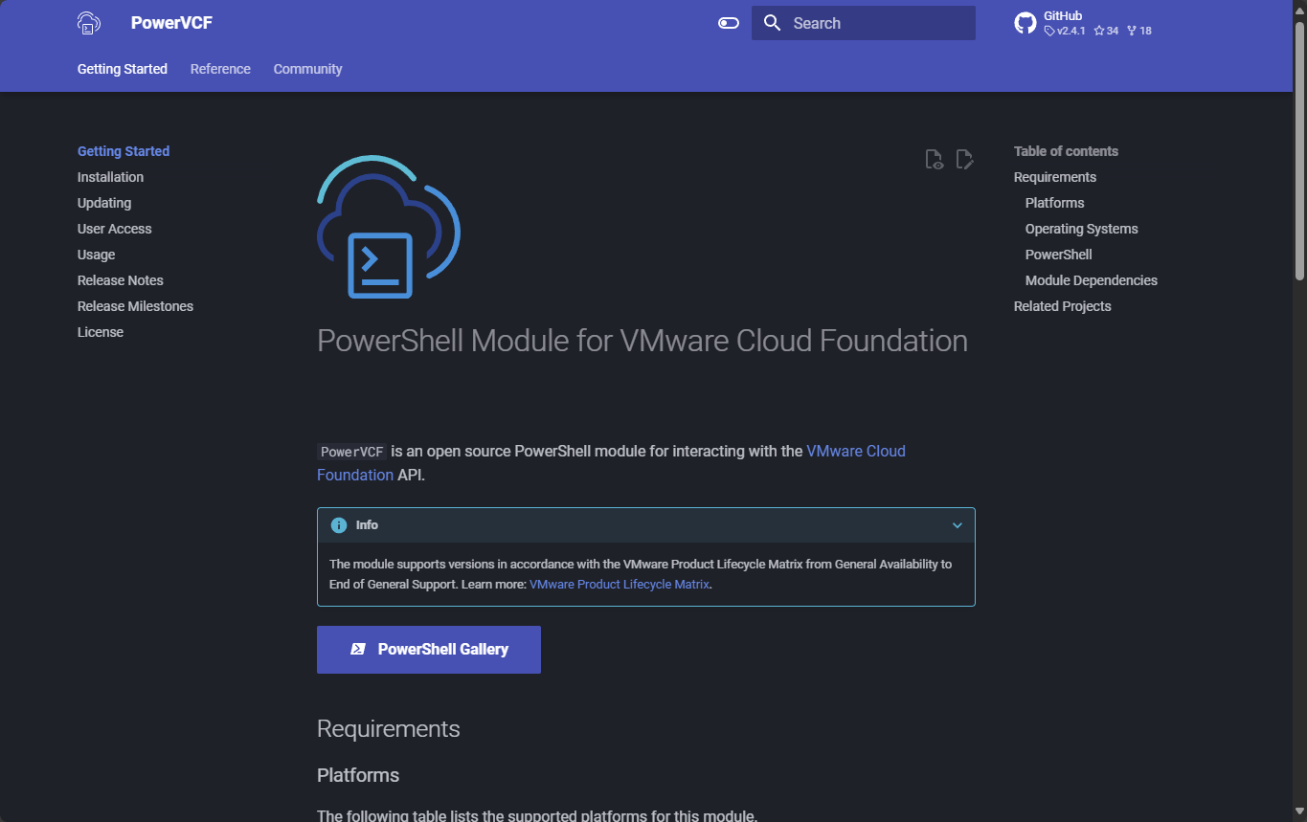
PowerVCF

Slide 7
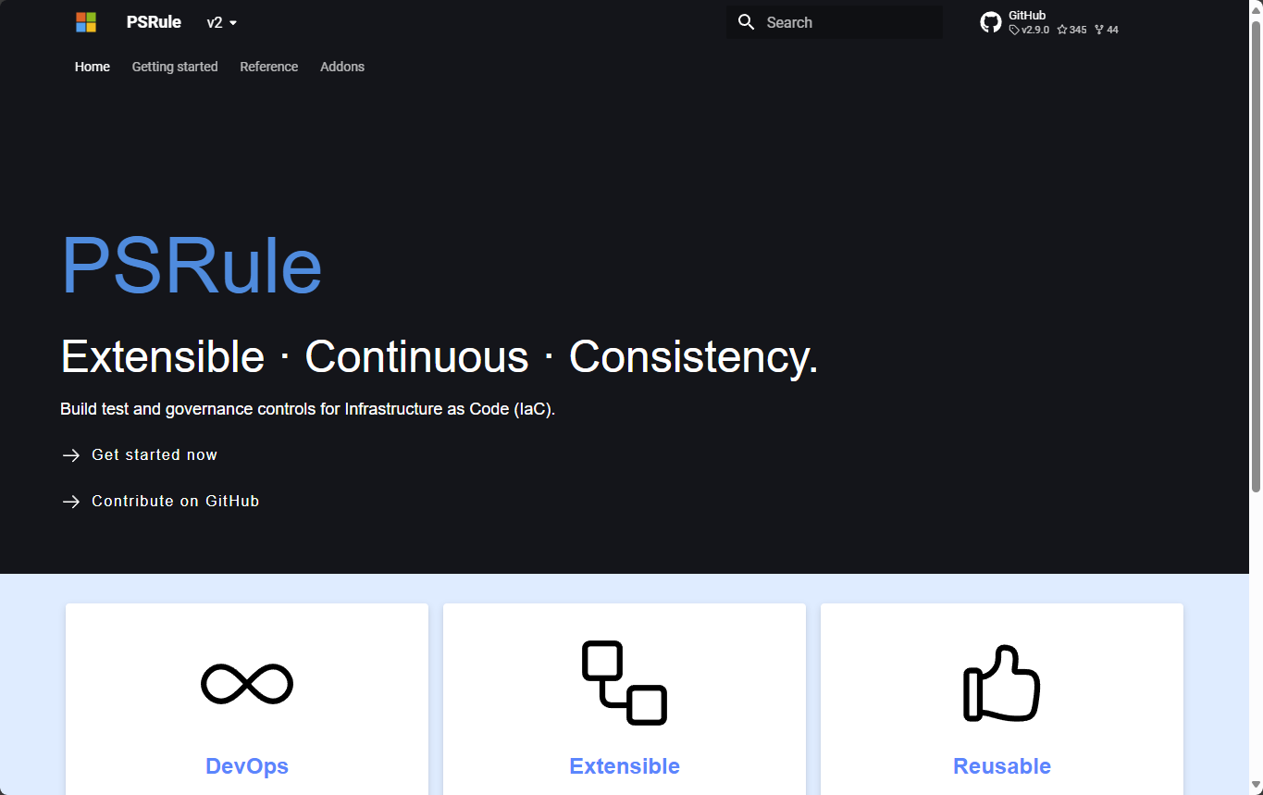
PSRule

Slide 8
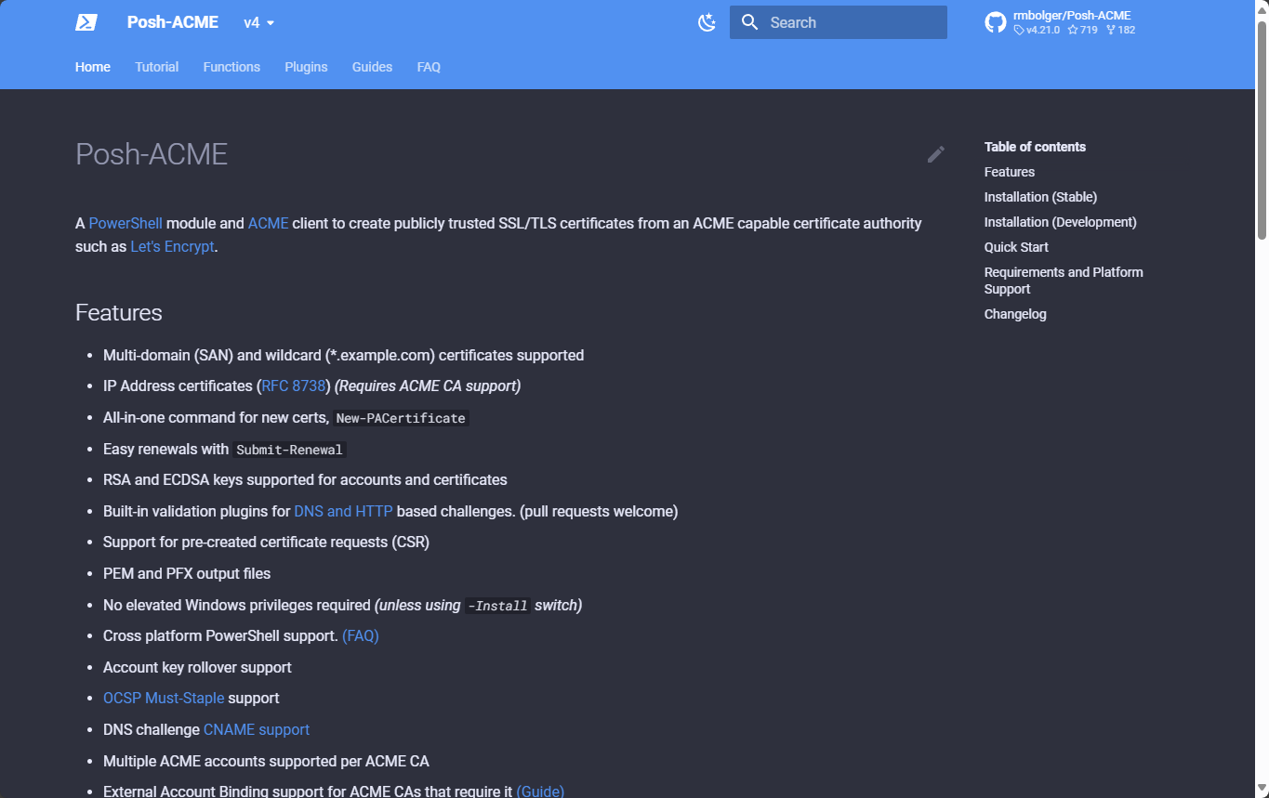
Posh-ACME

Slide 9
Why bother?
Get-Help only helps those who already know it’s there and have already installed your module.
Online docs are available to anyone, anywhere, no matter their experience.
Documentation demonstrates care and attention – it inspires confidence in those who would use it.
It also makes you look really good at your job

Slide 10
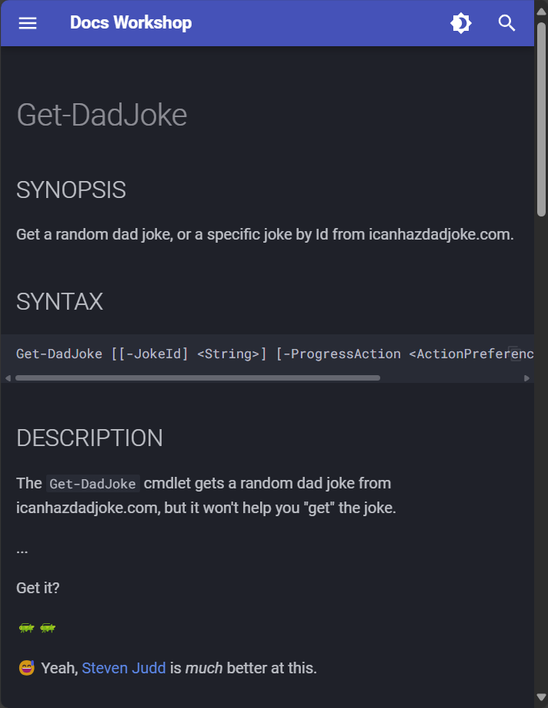
Agenda
Quick overview of the tools we’ll be using
Introduce the workshop materials GitHub Repository
Demonstrate the use of GitHub Codespaces
Step through the workshop materials and get comfortable with the tools
You will generate online documentation for a PowerShell module
Recommendation: Create a GitHub account now if you don’t have one

Slide 11
PlatyPS
WHAT?
WHY?!
Generates or updates markdown files from the Get-Help output from your module
Converts help in markdown format to MAML (as long as the markdown follows the PlatyPS schema)
Markdown is easier to read/edit
Avoid committing changes to code just to update docs
Lots of support for markdown with site generators
MAML is required for binary modules and for localization

Slide 12
MkDocs
Python-based static site generator
Generates site from markdown files
Large community and tons of extensions
Wide variety of themes available, but…
Material for MkDocs is the best theme!

Slide 13
Material for MkDocs
Has a large & active community
Beautiful, responsive, customizable
Has really good documentation
Open source and funded by sponsors
New features are released to sponsors first, and then to the greater community as funding targets are met

Slide 14
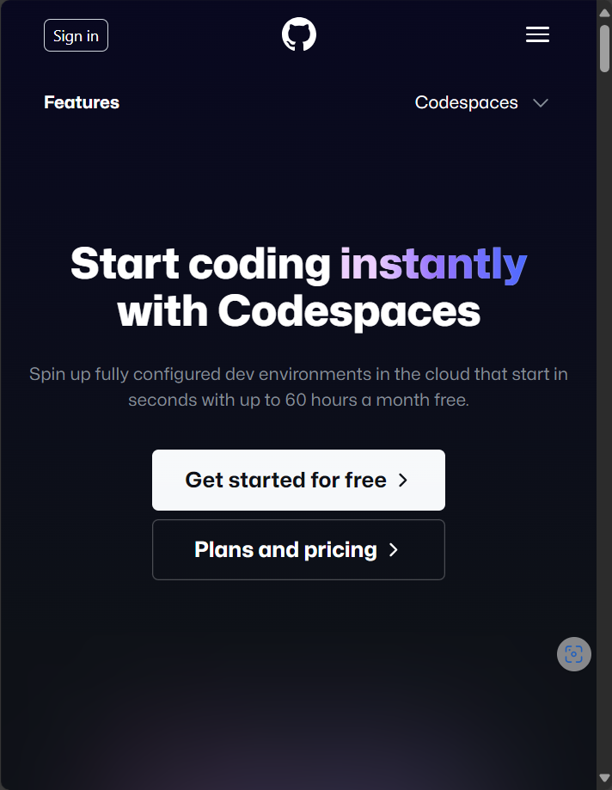
GitHub
Version control
Automation using GitHub Actions / workflows
Website hosting using GitHub Pages
Also, Codespaces are pretty dang cool

Slide 15
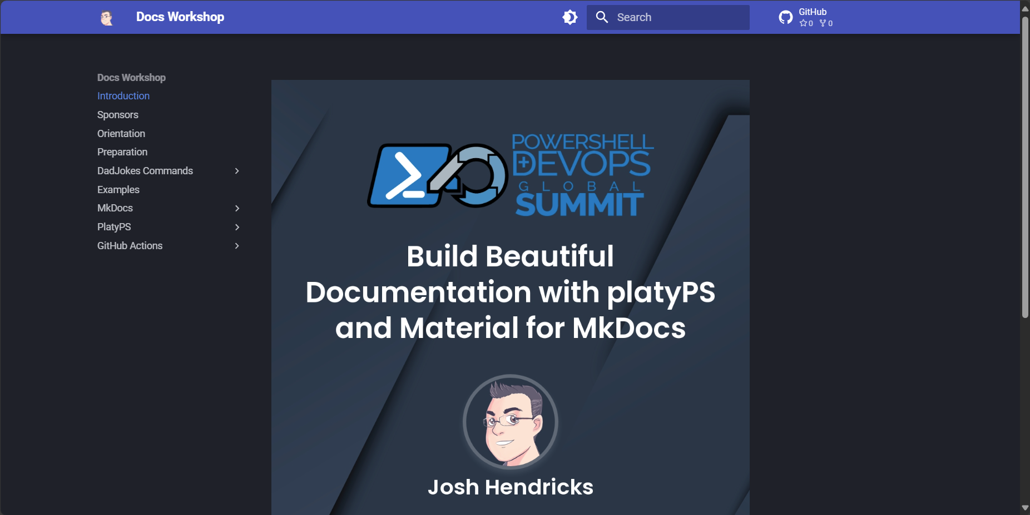
Start your browsers!
joshooaj.com/docs-workshop

Slide 16

THANK YOU
Please review this session

